Slide 1
Machine Learning Basics
Jen-Ing Hwang
Department of Computer Science and
Information Engineering
Fu Jen Catholic University

Slide 2
Outline
Introduction
Dataset (資料集合、Database)
Types of Learning
The Learning Problem
Learning Models
Machine Learning Stages (階段：1. 訓練 2. 測試)

Slide 3
Introduction
Machine learning focuses on constructing learning algorithms that can learn from data to acquire knowledge.
Machine learning是AI的子集合
給他data, 從中學習知識和概念
Deep Learning is part of Machine Learning, in which we use artificial neural networks models.
Machine learning 讓電腦變聰明的方法(用演算法)
AI
ML
AI (Artificial Intelligence)
ML (Machine Learning)
ANN (Artificial Neural Networks)
DL (Deep Learning)
ANN
DL

Slide 4
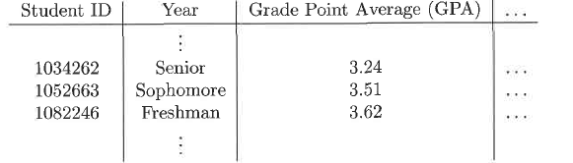
Dataset
Dataset: a collection of data examples and their attributes
行(Column): 同一個屬性 來描述一個物件的某個特徵
列(Object)：代表一個物件、一個example
Attributes
Examples
Figure adapted from Table 2.1 in Ref. [1]

Slide 5
Attribute and Example
Attribute (= feature, variable, characteristic, dimension , field)
a characteristic that explains the example
可以被分為input and output (label, target)
Example(= instance, object, sample, entity , record )
described by a group of related attributes

Slide 6
Dataset I: Numeric(有連續性) Input Attributes 例如溫度是 32 度
2 Numeric Input Attributes
output labels
Example (不是屬性) | Price (US Dollar) | Engine Power (Horsepower) | Family Cars
1 | 30,000 | 150 | Yes
2 | 23,000 | 120 | Yes
3 | 45,000 | 200 | No
4 | 34,000 | 140 | Yes
5 | 12,000 | 70 | No
5 Examples

Slide 7
Dataset II: Nominal(名義) Input Attributes 例如溫度可能有三種，hot, cool 跟 normal
output labels
6 Nominal Input Attributes
Example | Price | Engine Power | Maintenance | Persons | Trunk Size | Safety | Family Cars
1 | Medium | Moderate | Low | 4&more | Big | High | Yes
2 | Medium | Moderate | High | 4&more | Big | High | Yes
3 | High | Powerful | High | 4&more | Big | Low | No
4 | Medium | Moderate | Low | 4&more | Small | Low | Yes
4 Examples

Slide 8
Types of Attributes
Nominal values (名目式)
Nominal = 用文字來表示它的值
related to names, states or symbols
a finite(有限的) number of states
also referred to as symbolic values, categorical values, or discretized values
Examples: ID, name, and color
Numeric values (數值) <- 比較適合Deep learning
a measurable quantity
represented in integer or real values
an infinite(無限的) number of values
also referred to as continuous values(連續的屬性值)
Example: length, weight, and temperature
量化是最簡單可以去呈現資料的方法, 深度學習的 Input 都是數值

Slide 9
Types of Learning (1/2)
Supervised Learning (我給你答案 我監督你學習) ->已成熟
給的資料一定有Input和Output (會有對應的輸出結果->好像你有給它標準答案)
EX: 什麼樣的價格和Engine Power 會是Family Car
Training data with output labels (Output可以是數值也可以是名目)
Classification(分類): output labels are categories, e.g. “disease” and “no disease” -> Output是名目式的
Regression(迴歸): output labels are numeric values, e.g. height -> Output是數值式的
Unsupervised Learning(你沒有標準答案 沒有Output)
Training data without output labels
Clustering(分群): grouping similar instances
Reinforcement Learning(第一時間沒有Input 但之後會有獎賞或處罰)
Training algorithms receive no supervised output labels but use delayed reward(下贏) and punishment(下輸) to learn best actions -> ex:電腦下棋
分類 V.S. 分群
分類有Output ->已經知道答案 來做分類
分群沒有Output ->我沒有很明確的定義 但我希望你可以幫我判斷哪些人可以在一起
ex: Poker分群 (依顏色分兩群 or 依花色分四群 or 依人的圖樣跟數字分成兩群)

Slide 10
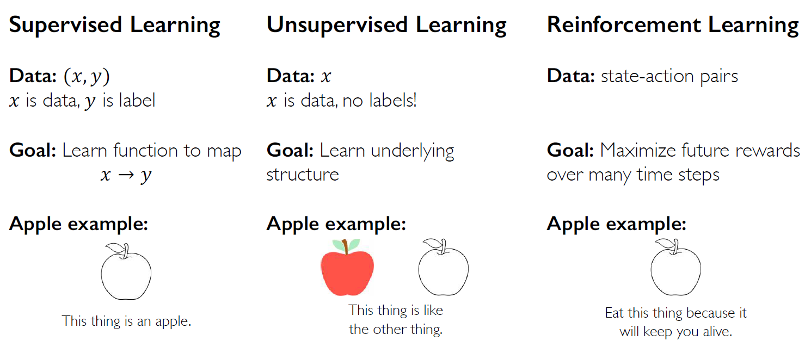
Types of Learning (2/2)
像不像(ex:身高體重)，用XY散佈圖的距離來判斷
學習對應關係
我有蘋果跟橘子
你沒有告訴我橘子和蘋果的規則
但你告訴我什麼是橘子和蘋果
有三個屬性 形狀 顏色 重量
蘋果和橘子的形狀和重量很像
能決定差異的可能是顏色
你沒有事先跟電腦說
只是把資料餵給它
他要自己想辦法找出這個規則

Slide 11
The Learning Problem
Components of Learning
Input
Output
Target function
Data
Hypothesis

Slide 12
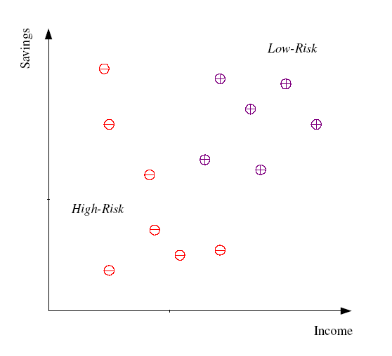
Example of Machine Learning
Credit card Approval
Figure adapted from Fig 1.1 in Ref. [2]

Slide 13
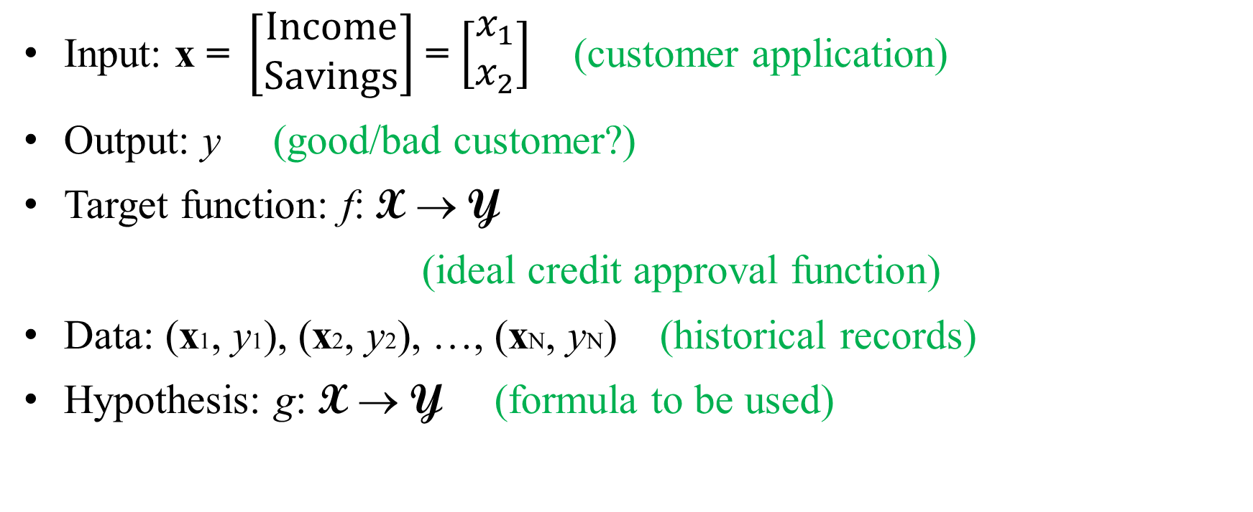
Components of Learning
Input: x $\text{= }\left[\begin{matrix}Income \\ Savings\end{matrix}\right]$ = $\left[\begin{matrix}x_{1} \\ x_{2}\end{matrix}\right]$ (customer application)
Output: y (good/bad customer?)
Target function: f: X → Y
(ideal credit approval function)
Data: (x1, y1), (x2, y2), …, (xN, yN) (historical records)
Hypothesis: g: X → Y (formula to be used)

Slide 14
Unknown Target Function: f: X → Y
(ideal credit approval function)
Training Examples: (x1, y1), (x2, y2), …, (xN, yN)
(historical records)
Learning
Algorithm
A
Final Hypothesis:
g ≈ f
(g ∈ H)
(g is the final credit
approval formula)
Hypothesis Set: H
(set of candidate formulas)
Figure adapted from Fig 1.2 in Ref. [3]

Slide 15
Learning Models
Two solution components of the learning problem:
The hypothesis set H; g ∈ H
The learning algorithm A
⇒ Together, they are referred to as the learning model.

Slide 16
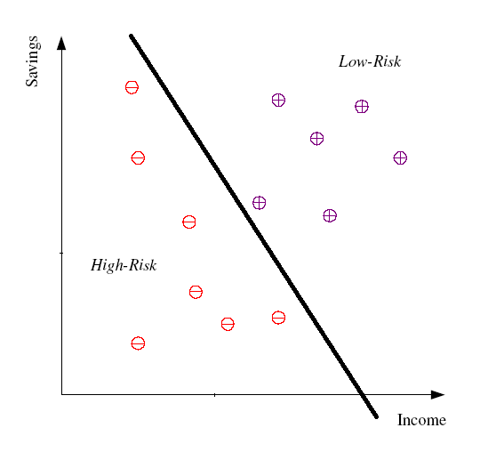
Model I: Linear Model 找到直線
The hypothesis set H; g ∈ H
H = A set of linear functions
The learning algorithm A
A = Perceptron Learning Algorithm (PLA)
⇒ Together, they are referred to as a linear model.

Slide 17
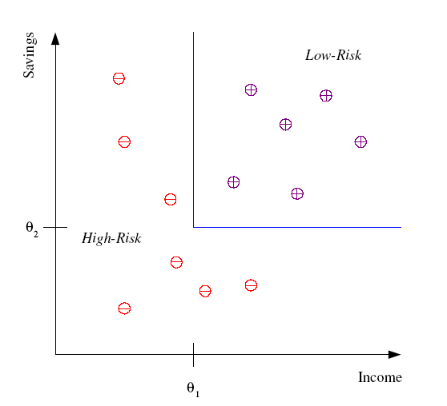
Model II: Rule-Based Model 找到規則
The hypothesis set H; g ∈ H
H = A set of rules
The learning algorithm A
A = Decision tree learning (e.g., ID3)
⇒ Together, they are referred to as a rule-based model.

Slide 18
Model III: Instance-Based Model
不做事 要找到新的案例出來，才找類似的案例，
把Data儲存起來，將來有案例才開始動
The hypothesis set H; g ∈ H
H = An implicit hypothesis set
The learning algorithm A
A = K-Nearest neighbor (KNN)(e.g., 1NN)
看要看以前的幾個案例ex: 可以找兩個案例，可能之前有兩個情節跟這個案例很像，一個判二十年，一個判十八年，基於這兩個案例，那我就判十九年
Note that KNN is a lazy learning approach that
stores data and waits for the query before
generalizing.
⇒ Together, they are referred to as a Instance-based model. ->基於以前的範例
基於以前的結果來判斷
Ex:類似的案例以前法官判二十年，這個案例就大約判二十年

Slide 19
Machine Learning Stages
Training Stage: Search a hypothesis to fit observed data.
Learning Model
Input
Output
Testing Stage: Predict the output labels for unseen examples.
Learning
Model
Predict Output
New Input

Slide 20
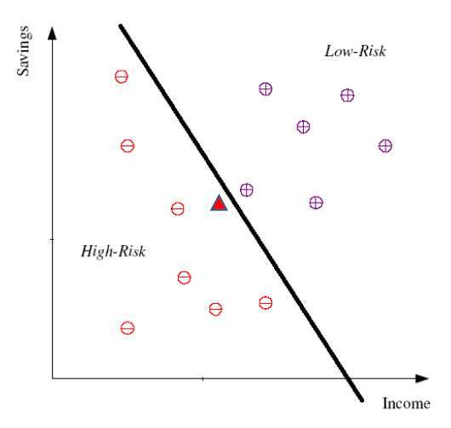
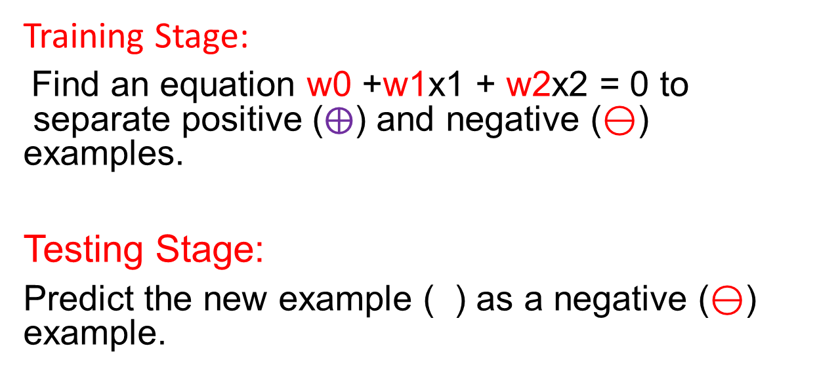
Model I: Linear Model
Training Stage:
Find an equation w0 +w1x1 + w2x2 = 0 to separate positive ($⨁$) and negative ($⊖$) examples.
Testing Stage:
Predict the new example ( ) as a negative ($⊖$) example.
不同的假說 不同的演算法
預測的答案會不一樣
Ex: 評審不一樣 得出來的結果也就不一樣

Slide 21
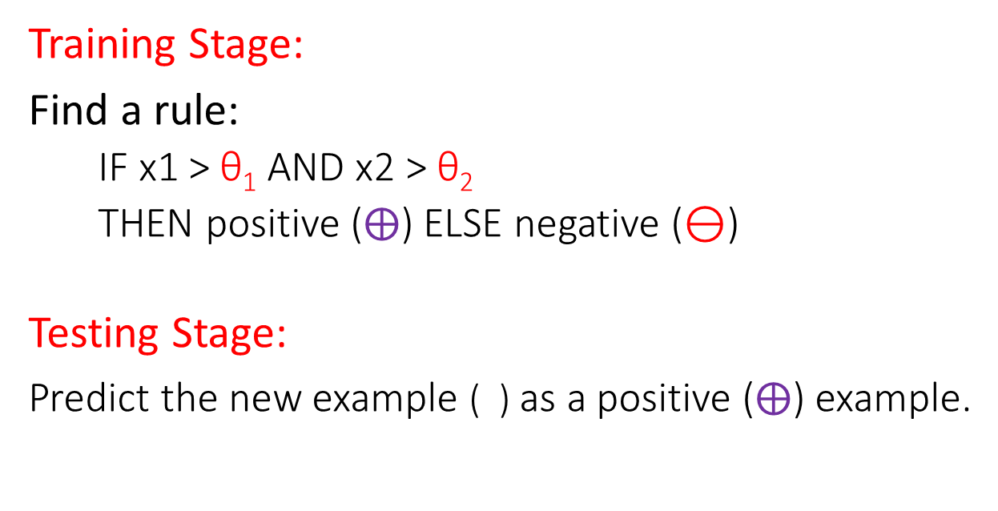
Model II: Rule-Based Model
Training Stage:
Find a rule:
IF x1 > θ₁ AND x2 > θ₂
THEN positive ($⨁$) ELSE negative ($⊖$)
Testing Stage:
Predict the new example ( ) as a positive ($⨁$) example.

Slide 22
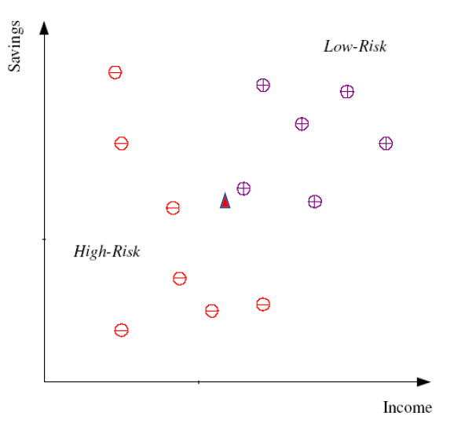
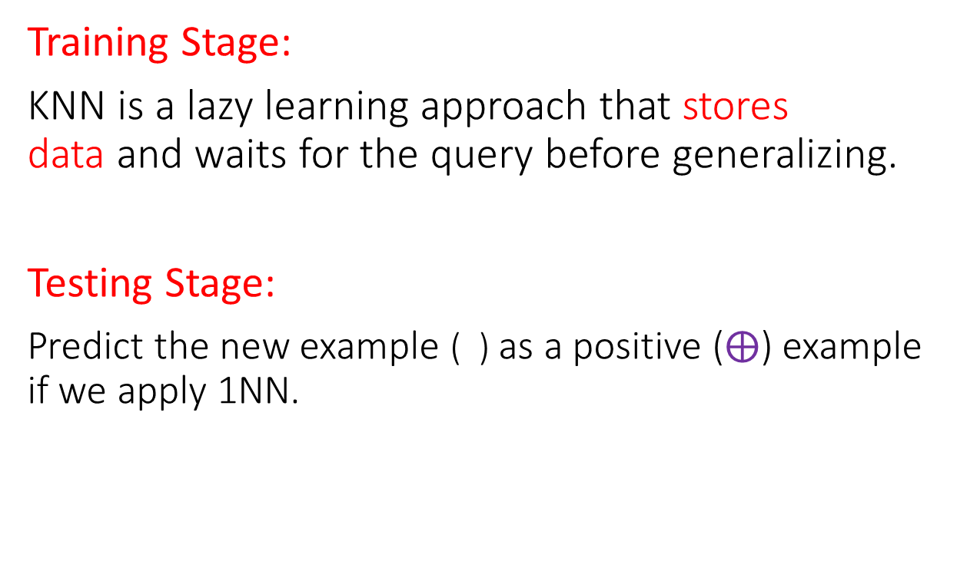
Model III: Instance-Based Model
Training Stage:
KNN is a lazy learning approach that stores data and waits for the query before generalizing.
Testing Stage:
Predict the new example ( ) as a positive ($⨁$) example if we apply 1NN.

Slide 23
Summary
Machine learning is a branch of artificial intelligence focusing on optimizing a performance criterion using example data.
Dataset: a collection of data examples and their attributes
Types of learning:
Supervised Learning, Unsupervised Learning, and Reinforcement Learning
The learning problem: Components of learning
Input, Output, Target function, Data, and Hypothesis
The learning model:
The hypothesis set and the algorithm
There are numerous machine learning models.
Machine learning stages are training and testing.

Slide 24
Kahoot
(T) 1. Deep Learning is part of machine learning, in which we use artificial neural networks models.
(F) 2. Artificial intelligence is a subfield of machine learning.
(F) 3. A nominal attribute assumes values that are integer or real.
(T) 4. A dataset is a collection of data examples and their attributes.
(F) 5. An unsupervised learning algorithm learns from a training dataset with both input attributes and output levels.
(T) 6. The machine learning stages are training and testing.

Slide 25
7. The output attributes of classification are:
(a) nominal values
(b) numeric values
(c) nominal or numeric values
(d) nominal and numeric values
8. Three types of machine learning are:
(a) deep learning, moderate learning, and shallow learning
(b) human learning, animal learning, and robotics learning
(c) supervised learning, unsupervised learning, and reinforcement learning
(d) visual learners, reading learners, and writing learners

Slide 26
9. Supervised learning can be divided into:
(a) classification and clustering
(b) classification and regression
(c) clustering and regression
(d) classification, clustering, and regression
10. What is the goal of clustering?
(a) Group similar instances
(b) Predict numerical values for testing examples
(c) Reduce the number of features
(d) None of the above

Slide 27
References
Introduction to Data Mining, 2nd edition, Pang-Ning Tan, Pearson, 2018.
Introduction to Machine Learning 3rd Edition, Ethem Alpaydin, 2014.
Learning from Data, Yaser S. Abu-Mostafa, Malik Magdon-Ismail, and Hsuan-Tien Lin, AMLBook, 2012.

